Slide 1


Advancing Salary Prediction & IT Skill Valuation: Text Driven Empirical Research using Machine Learning and NLP
This Photo by Unknown Author is licensed under CC BY-NC-ND
Nikhil Narayane
4th year PhD Candidate,
University of Tennessee, Knoxville
Joint work with:
Dr. Yuanyang Liu & Dr. Chuanren Liu
University of Texas at Permian Basin, March 20th, 2025
Notes:
Good morning, good evening to you .
First of all, thank you for taking the time out of your busy schedule to meet in your evening time zone.
My today’s topic of presentation is Advancing Salary Prediction & IT Skill Valuation. Today’s topic is based on my doctoral research with Dr. Yang and Dr. Charles.
As the title suggests, my work is divided into two parts, the first part talks about advancing salary prediction whereas the second part builds up on the first part and talks about IT skill valuation.

Slide 2
Index
Advancing Salary Prediction
Motivation and Contributions
Existing Approaches in Literature
Data and Methodology
Results
Conclusions
$ Value of Skills
Motivation and Contributions
Existing Approaches in Literature
Methodology
Results
Conclusions
Skill Complementarity
Motivation and Contributions
Existing Approaches in Literature
Methodology
Results
Conclusions
Notes:
Understanding Skill Comolementarity is important because this information can be used by
Individual to identify the combination of skills to invest to produce higher salary jump
Employers use these skill combination to increase the output of their team
Again, Policy makers can use this

Slide 3
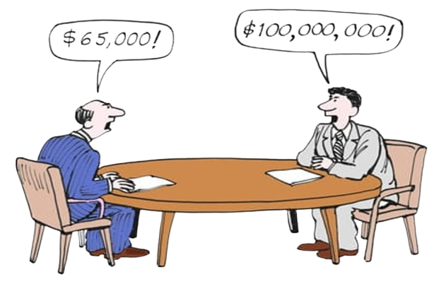
A Typical Job Interview
Career Advancement,
Organization’s Reputation,
Job Security,
Monetary Compensation
Talent Attraction & Retention,
Increase Productivity,
Diversity,
Monetary Compensation
Employer
Prospective Candidate
Notes:
Understanding Skill Comolementarity is important because this information can be used by
Individual to identify the combination of skills to invest to produce higher salary jump
Employers use these skill combination to increase the output of their team
Again, Policy makers can use this

Slide 4
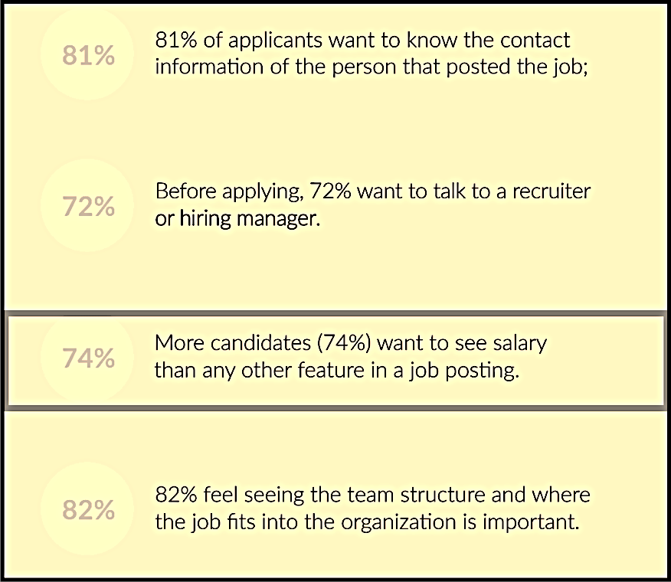
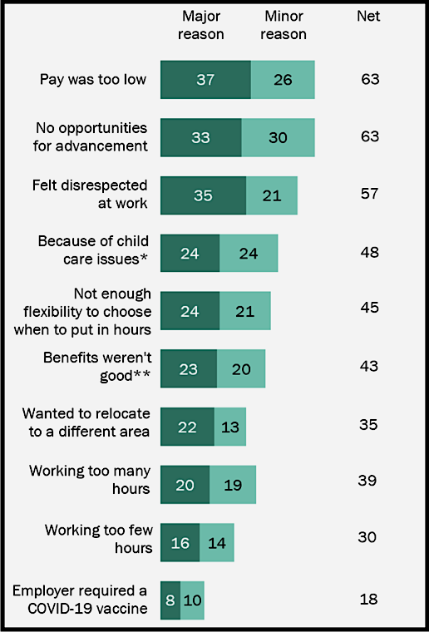
Salary is a Key Factor for Job Seekers
75% candidates want to see Salary Information
63% candidates cite low pay primary driver for quitting job
Career Builder Survey
Pew Research Center
Notes:
Understanding Skill Comolementarity is important because this information can be used by
Individual to identify the combination of skills to invest to produce higher salary jump
Employers use these skill combination to increase the output of their team
Again, Policy makers can use this

Slide 5
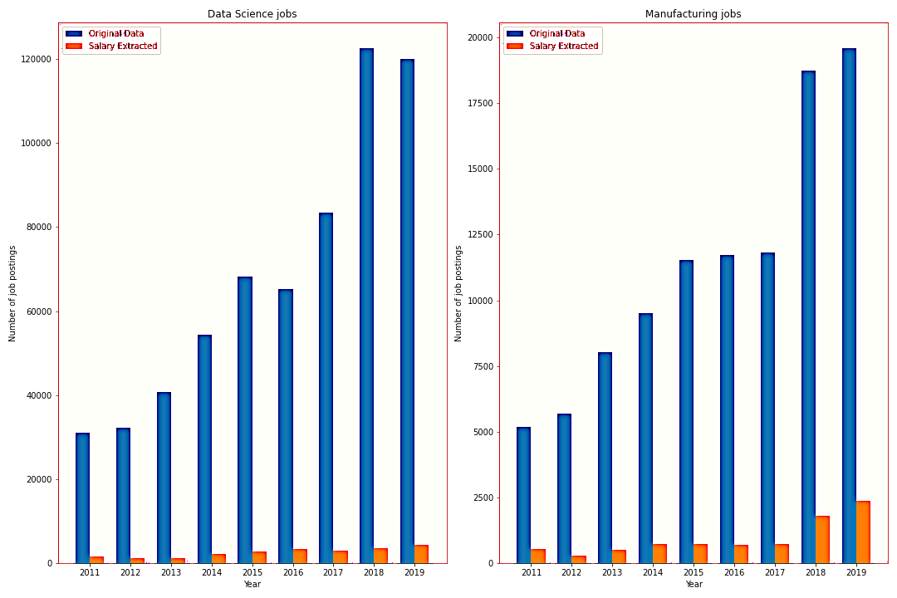
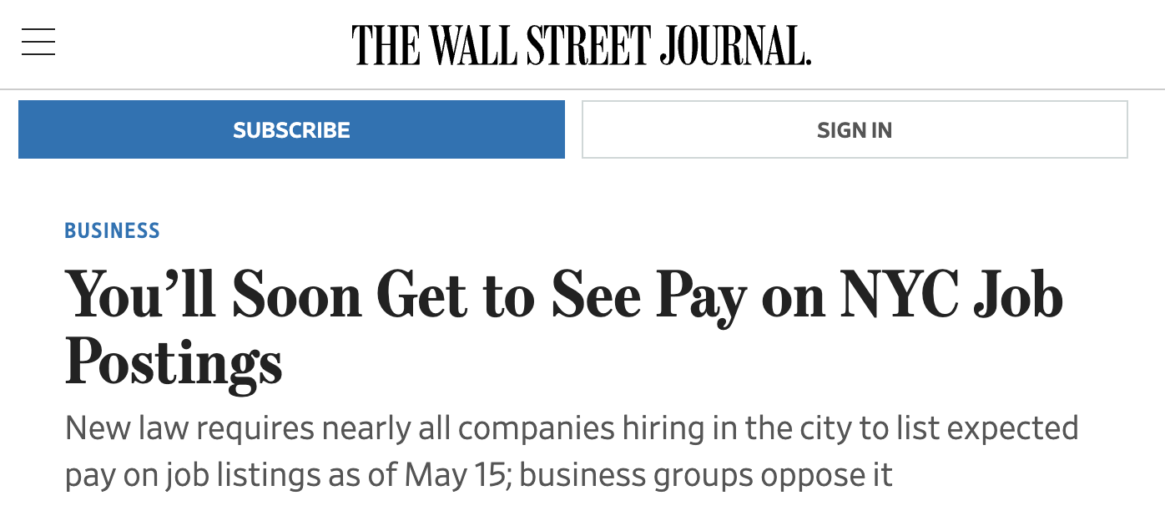
Challenge: No Salary Data in Job Postings
Percentage of job postings with salary ranges mentioned is staggeringly low at 12% in 2022 (CNN)
In our datasets, around 4% of our Data Science and Manufacturing job postings contain salary information
While the number of job postings have increased over the years, the salary information is still absent from many job postings
Notes:
Understanding Skill Comolementarity is important because this information can be used by
Individual to identify the combination of skills to invest to produce higher salary jump
Employers use these skill combination to increase the output of their team
Again, Policy makers can use this

Slide 6
Existing Approaches to Estimate Salary
Employer Salary Surveys
Crowdsourced Data
Government Labor Data
Data is collected by HR and given to big consulting firms for further analysis, but they are not public.
Ex: The compensation handbook by Berger Lane, Berger Dorothy, etc.
Notes:
Understanding Skill Comolementarity is important because this information can be used by
Individual to identify the combination of skills to invest to produce higher salary jump
Employers use these skill combination to increase the output of their team
Again, Policy makers can use this

Slide 7



Existing Approaches to Estimate Salary
Employer Salary Surveys
Crowdsourced Data
Government Labor Data
Data is collected by HR and given to big consulting firms for further analysis, but they are not public.
Ex: The compensation handbook by Berger Lane, Berger Dorothy, etc.
Notes:
Understanding Skill Comolementarity is important because this information can be used by
Individual to identify the combination of skills to invest to produce higher salary jump
Employers use these skill combination to increase the output of their team
Again, Policy makers can use this

Slide 8
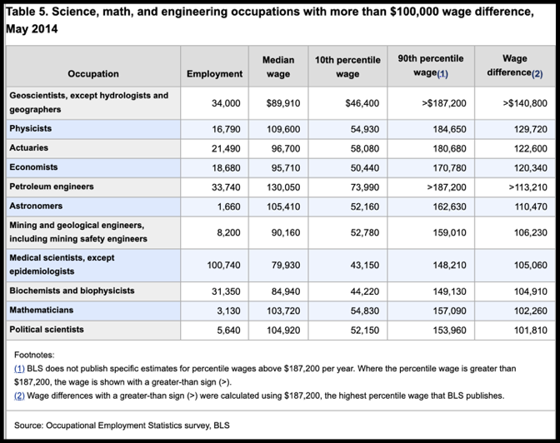
Existing Approaches to Estimate Salary
Employer Salary Surveys
Crowdsourced Data
Government Labor Data
Data is collected by HR and given to big consulting firms for further analysis, but they are not public.
Ex: The compensation handbook by Berger Lane, Berger Dorothy, etc.
Notes:
Understanding Skill Comolementarity is important because this information can be used by
Individual to identify the combination of skills to invest to produce higher salary jump
Employers use these skill combination to increase the output of their team
Again, Policy makers can use this

Slide 9
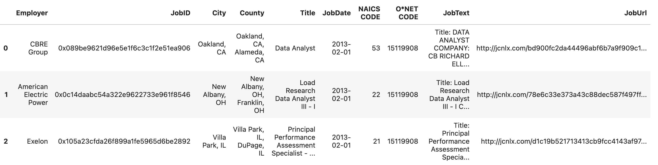
We use BGT Data Science Job Postings
BGT updates its data in real time
Excellent source of understanding job market demand
We use Data Science job postings for our analysis
4.2 Miillion Data Science Job Postings
Lightcast (originally Burning Glass Technology, (BGT) Job postings
BGT compiles data from over 40,000 sources, approximately 60-70% of the total US market
Features Used in Our Framework
state: extracted from County
year, month: extracted from job posting date
salary values: extracted from job text
NAICS Code: North American Industry Classification Code
Notes:
Understanding Skill Comolementarity is important because this information can be used by
Individual to identify the combination of skills to invest to produce higher salary jump
Employers use these skill combination to increase the output of their team
Again, Policy makers can use this

Slide 10
Related Works on Salary Estimation
Salary Benchmarking
Salary Prediction
Bana et al (2022): Used BERT Embeddings in Convolutional Neural Network (CNN) to predict Salary
Meng et al.(2018): Developed “Holistic Salary Benchmarking Matrix Factorization (HSBMF)” technique, utilizing extensive online recruitment data to incorporate elements like company similarity and job characteristics, along with spatial-temporal dynamics, into salary predictions.
Meng et al.(2022): Developed the Nonparametric-Dirichlet process-based latent factor model (NDP-JSB)
Notes:
Understanding Skill Comolementarity is important because this information can be used by
Individual to identify the combination of skills to invest to produce higher salary jump
Employers use these skill combination to increase the output of their team
Again, Policy makers can use this

Slide 11
Related Works on Salary Estimation
Salary Benchmarking
Salary Prediction
Bana et al (2022): Used BERT Embeddings in Convolutional Neural Network (CNN) to predict Salary
Meng et al.(2018): Developed “Holistic Salary Benchmarking Matrix Factorization (HSBMF)” technique, utilizing extensive online recruitment data to incorporate elements like company similarity and job characteristics, along with spatial-temporal dynamics, into salary predictions.
Meng et al.(2022): Developed the Nonparametric-Dirichlet process-based latent factor model (NDP-JSB)
Limitations:
The methods were too complicated
The methodology employed had inherent limitations of number of tokens
Notes:
Understanding Skill Comolementarity is important because this information can be used by
Individual to identify the combination of skills to invest to produce higher salary jump
Employers use these skill combination to increase the output of their team
Again, Policy makers can use this

Slide 12
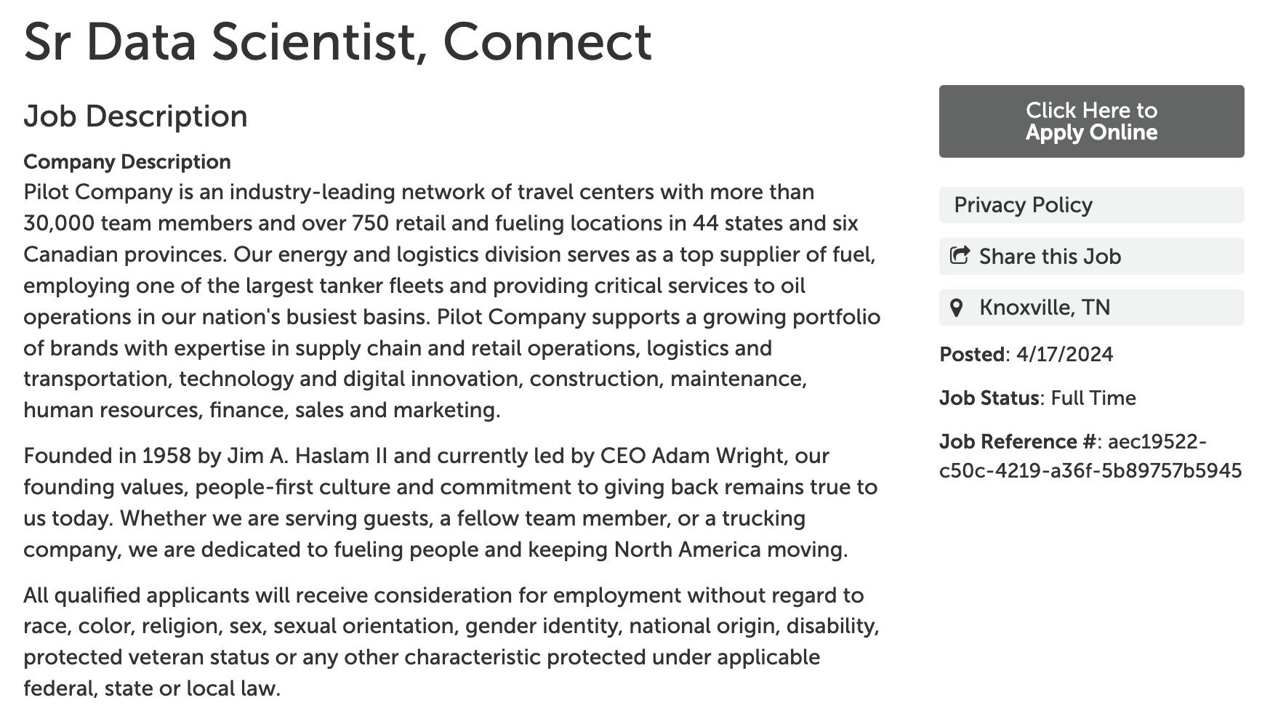
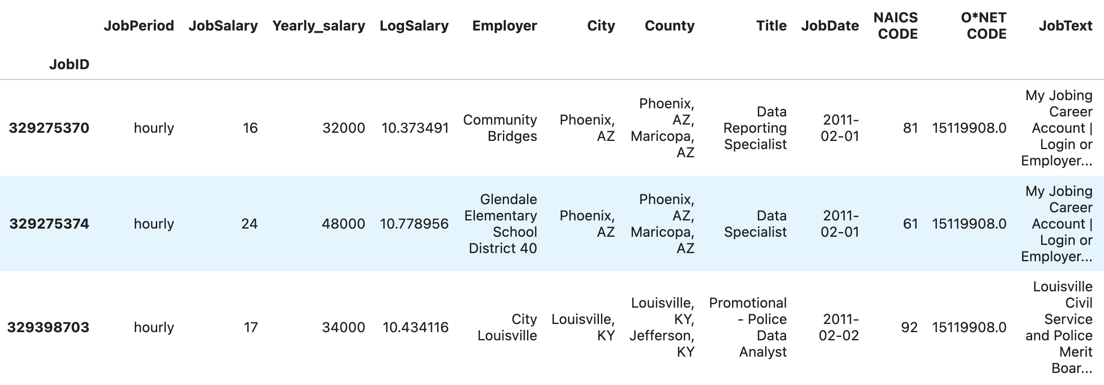


We Predict Salaries from Job Postings
4.2 Million Job Postings
254k Postings with Salary
AutoML Predictive Model for Salaries
Text to Vector Embedding Models for Job Title and Text
We predict salaries by transforming unstructured job descriptions into structured data using state-of-the-art machine learning algorithms.
Notes:
Understanding Skill Comolementarity is important because this information can be used by
Individual to identify the combination of skills to invest to produce higher salary jump
Employers use these skill combination to increase the output of their team
Again, Policy makers can use this

Slide 13
From Text to Embeddings
Job Title to Vector
Hyperparameter Configuration Details
Job Title
TF-IDF Generator
Embedding of Dimension 75
Embedding Model | Hyperparameter Details
TF-IDF | Job Title - Minimum document frequency: 300, Maximum document frequency: 95%, Vector size range: 75 Job Text - Minimum document frequency: 1%, Maximum document frequency: 20%, Vector size range: 3000
Word2Vec | Model: word2vec-google-news-300, Embedding size: 300, Method: Average of sentence embeddings
Doc2Vec | Vector size range: 300-1800, Training epochs: 4-12
BERT | Model: MiniLM-L6-v2, Maximum tokens: 512, Minimum embedding size: 768, Maximum embedding size: 1024
OpenAI ada-002 | Maximum input size: 8191, Embedding size: 1536, MTEB evaluation accuracy: 61%
OpenAI 3-large | Maximum input size: 8191, Embedding size: 3072, MTEB evaluation accuracy: 64.6%
Job Text to Vector
Job Text
BGT
TF-IDF Embedding Vectors of Dimension 3000
Embedding Models
TF-IDF
Notes:
Understanding Skill Comolementarity is important because this information can be used by
Individual to identify the combination of skills to invest to produce higher salary jump
Employers use these skill combination to increase the output of their team
Again, Policy makers can use this

Slide 14


AutoML: Predictive Algorithm
Job Title
Job Text
Month
State
NAICS Code
Year
Embedding
Embedding
One-hot Encoding
One-hot Encoding
One-hot Encoding
Continuous
Stacked Ensemble
Model
Model Input Features
Log
Salary
Automatic Hyperparameter Tuning
Ensemble of Multiple Models
Flexibility of Training Duration
Key Features of Our Predictive Algorithm
Notes:
Understanding Skill Comolementarity is important because this information can be used by
Individual to identify the combination of skills to invest to produce higher salary jump
Employers use these skill combination to increase the output of their team
Again, Policy makers can use this

Slide 15
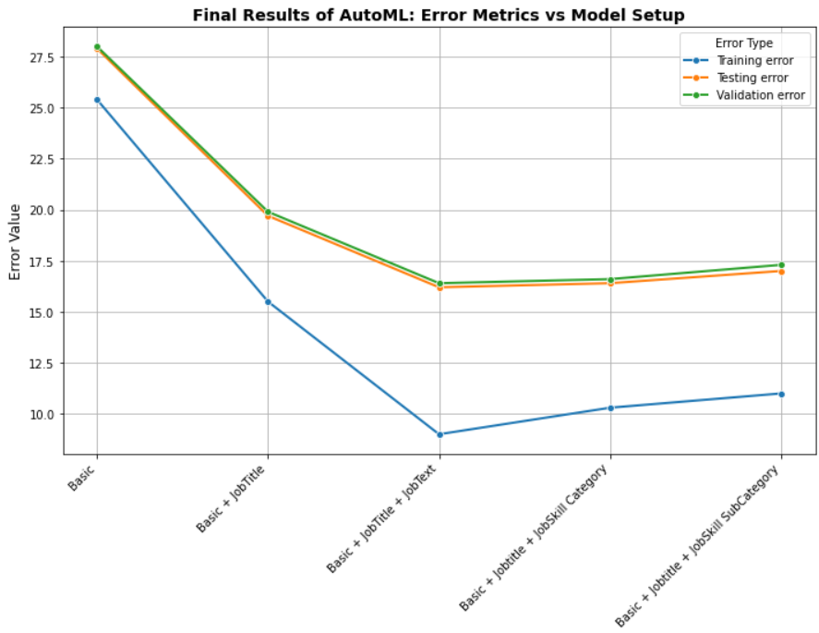
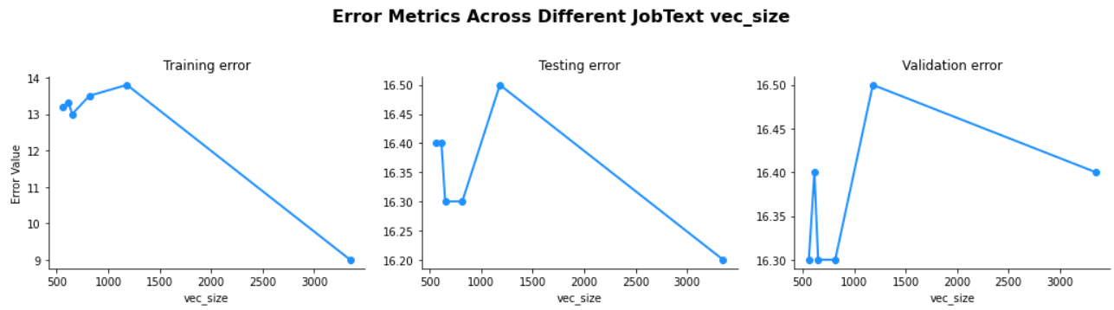
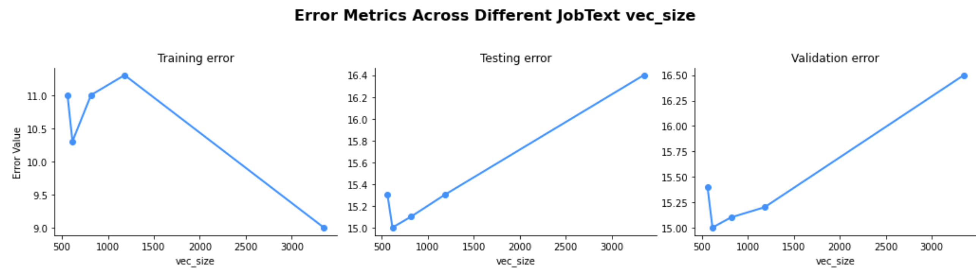
Robustness of our Model
Importance of Job Text can be seen with reduced error rates
AutoML provides flexible training time that allows us to test robustness of our approach
Results with 8 hours of model training
Our approach is accurate and flexible, trained on large scale job postings
Results with 15 hours of model training
Notes:
Understanding Skill Comolementarity is important because this information can be used by
Individual to identify the combination of skills to invest to produce higher salary jump
Employers use these skill combination to increase the output of their team
Again, Policy makers can use this

Slide 16
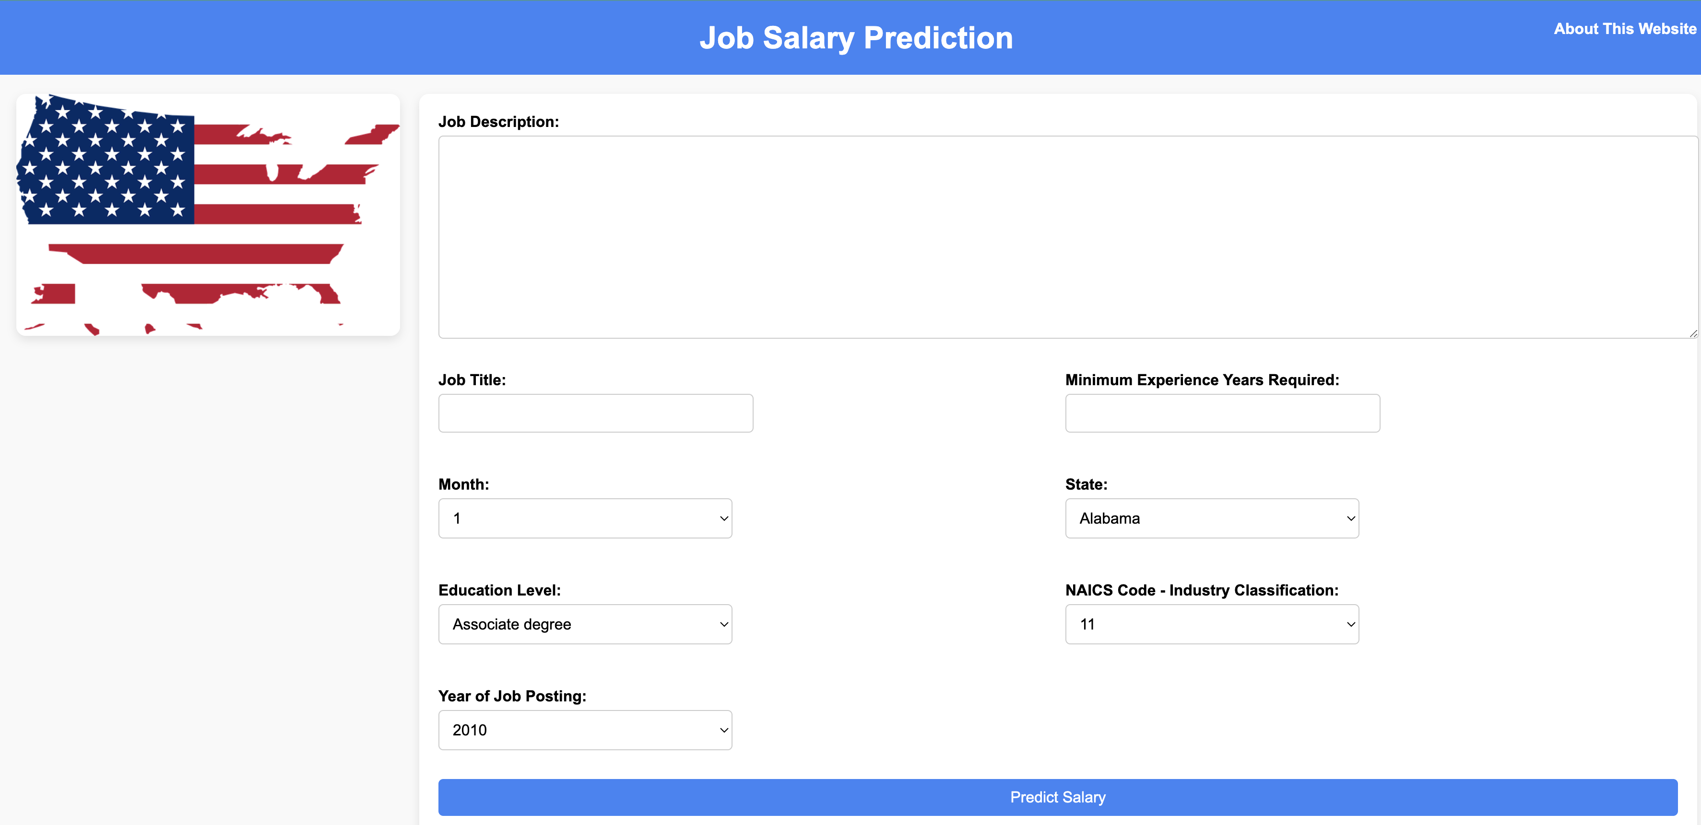
Website - Demonstration
https://tiny.utk.edu/job
Notes:
Understanding Skill Comolementarity is important because this information can be used by
Individual to identify the combination of skills to invest to produce higher salary jump
Employers use these skill combination to increase the output of their team
Again, Policy makers can use this

Slide 17
Contributions
Achieved a remarkable 85% out-of-sample prediction accuracy,
setting a new standard in the field
Enhanced Prediction Accuracy
Comprehensive Text Analysis
Universal Framework Development
Crafted a flexible and versatile salary prediction framework, applicable across diverse job markets
Utilizing the entire job description for analysis, surpassing previous methods that relied on truncated texts and limited features
Notes:
Understanding Skill Comolementarity is important because this information can be used by
Individual to identify the combination of skills to invest to produce higher salary jump
Employers use these skill combination to increase the output of their team
Again, Policy makers can use this

Slide 18
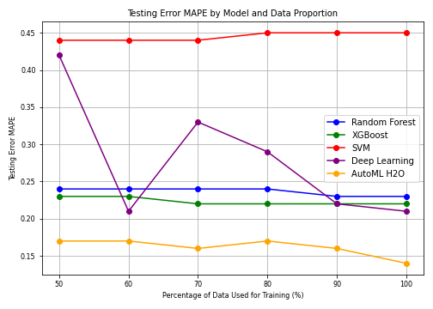
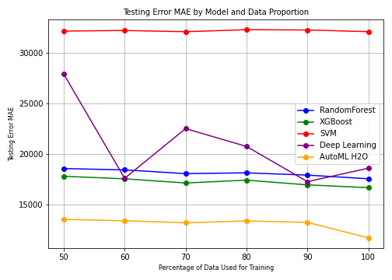
AutoML Ensemble Model Creates Best Predictions
MAPE: Mean Absolute Percentage Error (Lower is better)
MAE: Mean Absolute Error (Lower is better)
AutoML H2O achieves the lowest test MAE, highlighting its exceptional performance and stability.
Tree-based methods, particularly Random Forest and XGBoost, perform better than conventional algorithms such as SVM.
Deep Learning models show improved error rates with larger datasets, indicating scalability and potential gains with more extensive training data.
Notes:
In the figure we see that the testing error goes below 15% but with the new data and some code checks, the lowest error we see is 16%

Slide 19
Concluding Remarks
Implications of MAPE
Understanding MAPE: For an estimated salary of $100,000, the actual salary will likely range from $85,000 to $115,000 (assuming MAPE = 15%).
Confidence Level: Demonstrates high reliability in salary predictions.
Industry Impact
Addressing a Key Challenge: Overcomes the common issue of missing salary data in job descriptions.
Benchmark Achievement: Sets a new benchmark in salary prediction from job descriptions.
Notes:
Understanding Skill Comolementarity is important because this information can be used by
Individual to identify the combination of skills to invest to produce higher salary jump
Employers use these skill combination to increase the output of their team
Again, Policy makers can use this

Slide 20

Certain Pertinent Questions
Knowing how much a job pays is valuable, but the next logical question is: “What can I do to increase my salary?” The most actionable way to increase earning potential is by developing high-value skills.
Notes:
Understanding Skill Comolementarity is important because this information can be used by
Individual to identify the combination of skills to invest to produce higher salary jump
Employers use these skill combination to increase the output of their team
Again, Policy makers can use this

Slide 21

Monetary Valuation of Skills
From Salary Prediction to Skill Valuation

Slide 22
Motivation for Skill Valuation
Monetary Importance of Job Characteristics
Skill Terms
Government’s Skill Development
Value of skills can determine government’s investment
Compensation by Companies
Expected compensation change for “skilled” workers
Certificates
Workforce planning
Salary negotiation
Hiring decisions
Smart Skill Investment
Target skills with the highest market value
Calculate potential ROI for training
Strategic Certification Planning
Evaluate certification costs against potential salary increases
Data-driven decisions about professional development
Policy & Workforce Development
Government reskilling initiatives
Align training programs with market needs
Notes:
Understanding Skill Comolementarity is important because this information can be used by
Individual to identify the combination of skills to invest to produce higher salary jump
Employers use these skill combination to increase the output of their team
Again, Policy makers can use this

Slide 23
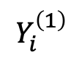

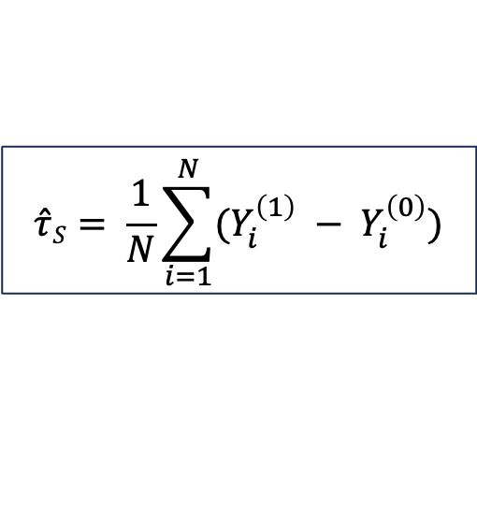
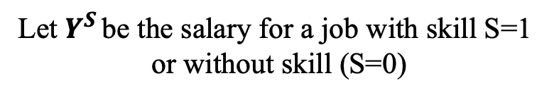
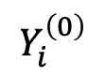
Calculating Monetary Value of Skills
Data Scientist Job Postings
Jobs containing skill term
Jobs not containing skill term
Cosine similarity>=0.6
Matching jobs on state, year, NAICS Code
Let $Y^{S }\text{be} \text{the} \text{salary} \text{for} \text{a} \text{job} \text{with} \text{skill} \text{S}\text{=1 }$
$$\text{or} \text{without} \text{skill}\text{ (}\text{S}\text{=0) }$$
$$Y_{i}^{\left(1\right)}$$
$$Y_{i}^{\left(0\right)}$$
Matched Jobs containing skill term
Let $\hat{τ}S$ = Average Monetary Value of Skill S
$$\hat{τ}S= \frac{1}{N}\sum_{i=1}^{N}{(Y_{i}^{\left(1\right)} − Y_{i}^{\left(0\right)})}$$
Benefits of this approach
Statistically robust methodology
Validated through multiple data sources
Offers reliable value estimation
Matching jobs on job text embedding
Matched Jobs not containing skill term
Notes:
Understanding Skill Comolementarity is important because this information can be used by
Individual to identify the combination of skills to invest to produce higher salary jump
Employers use these skill combination to increase the output of their team
Again, Policy makers can use this

Slide 24
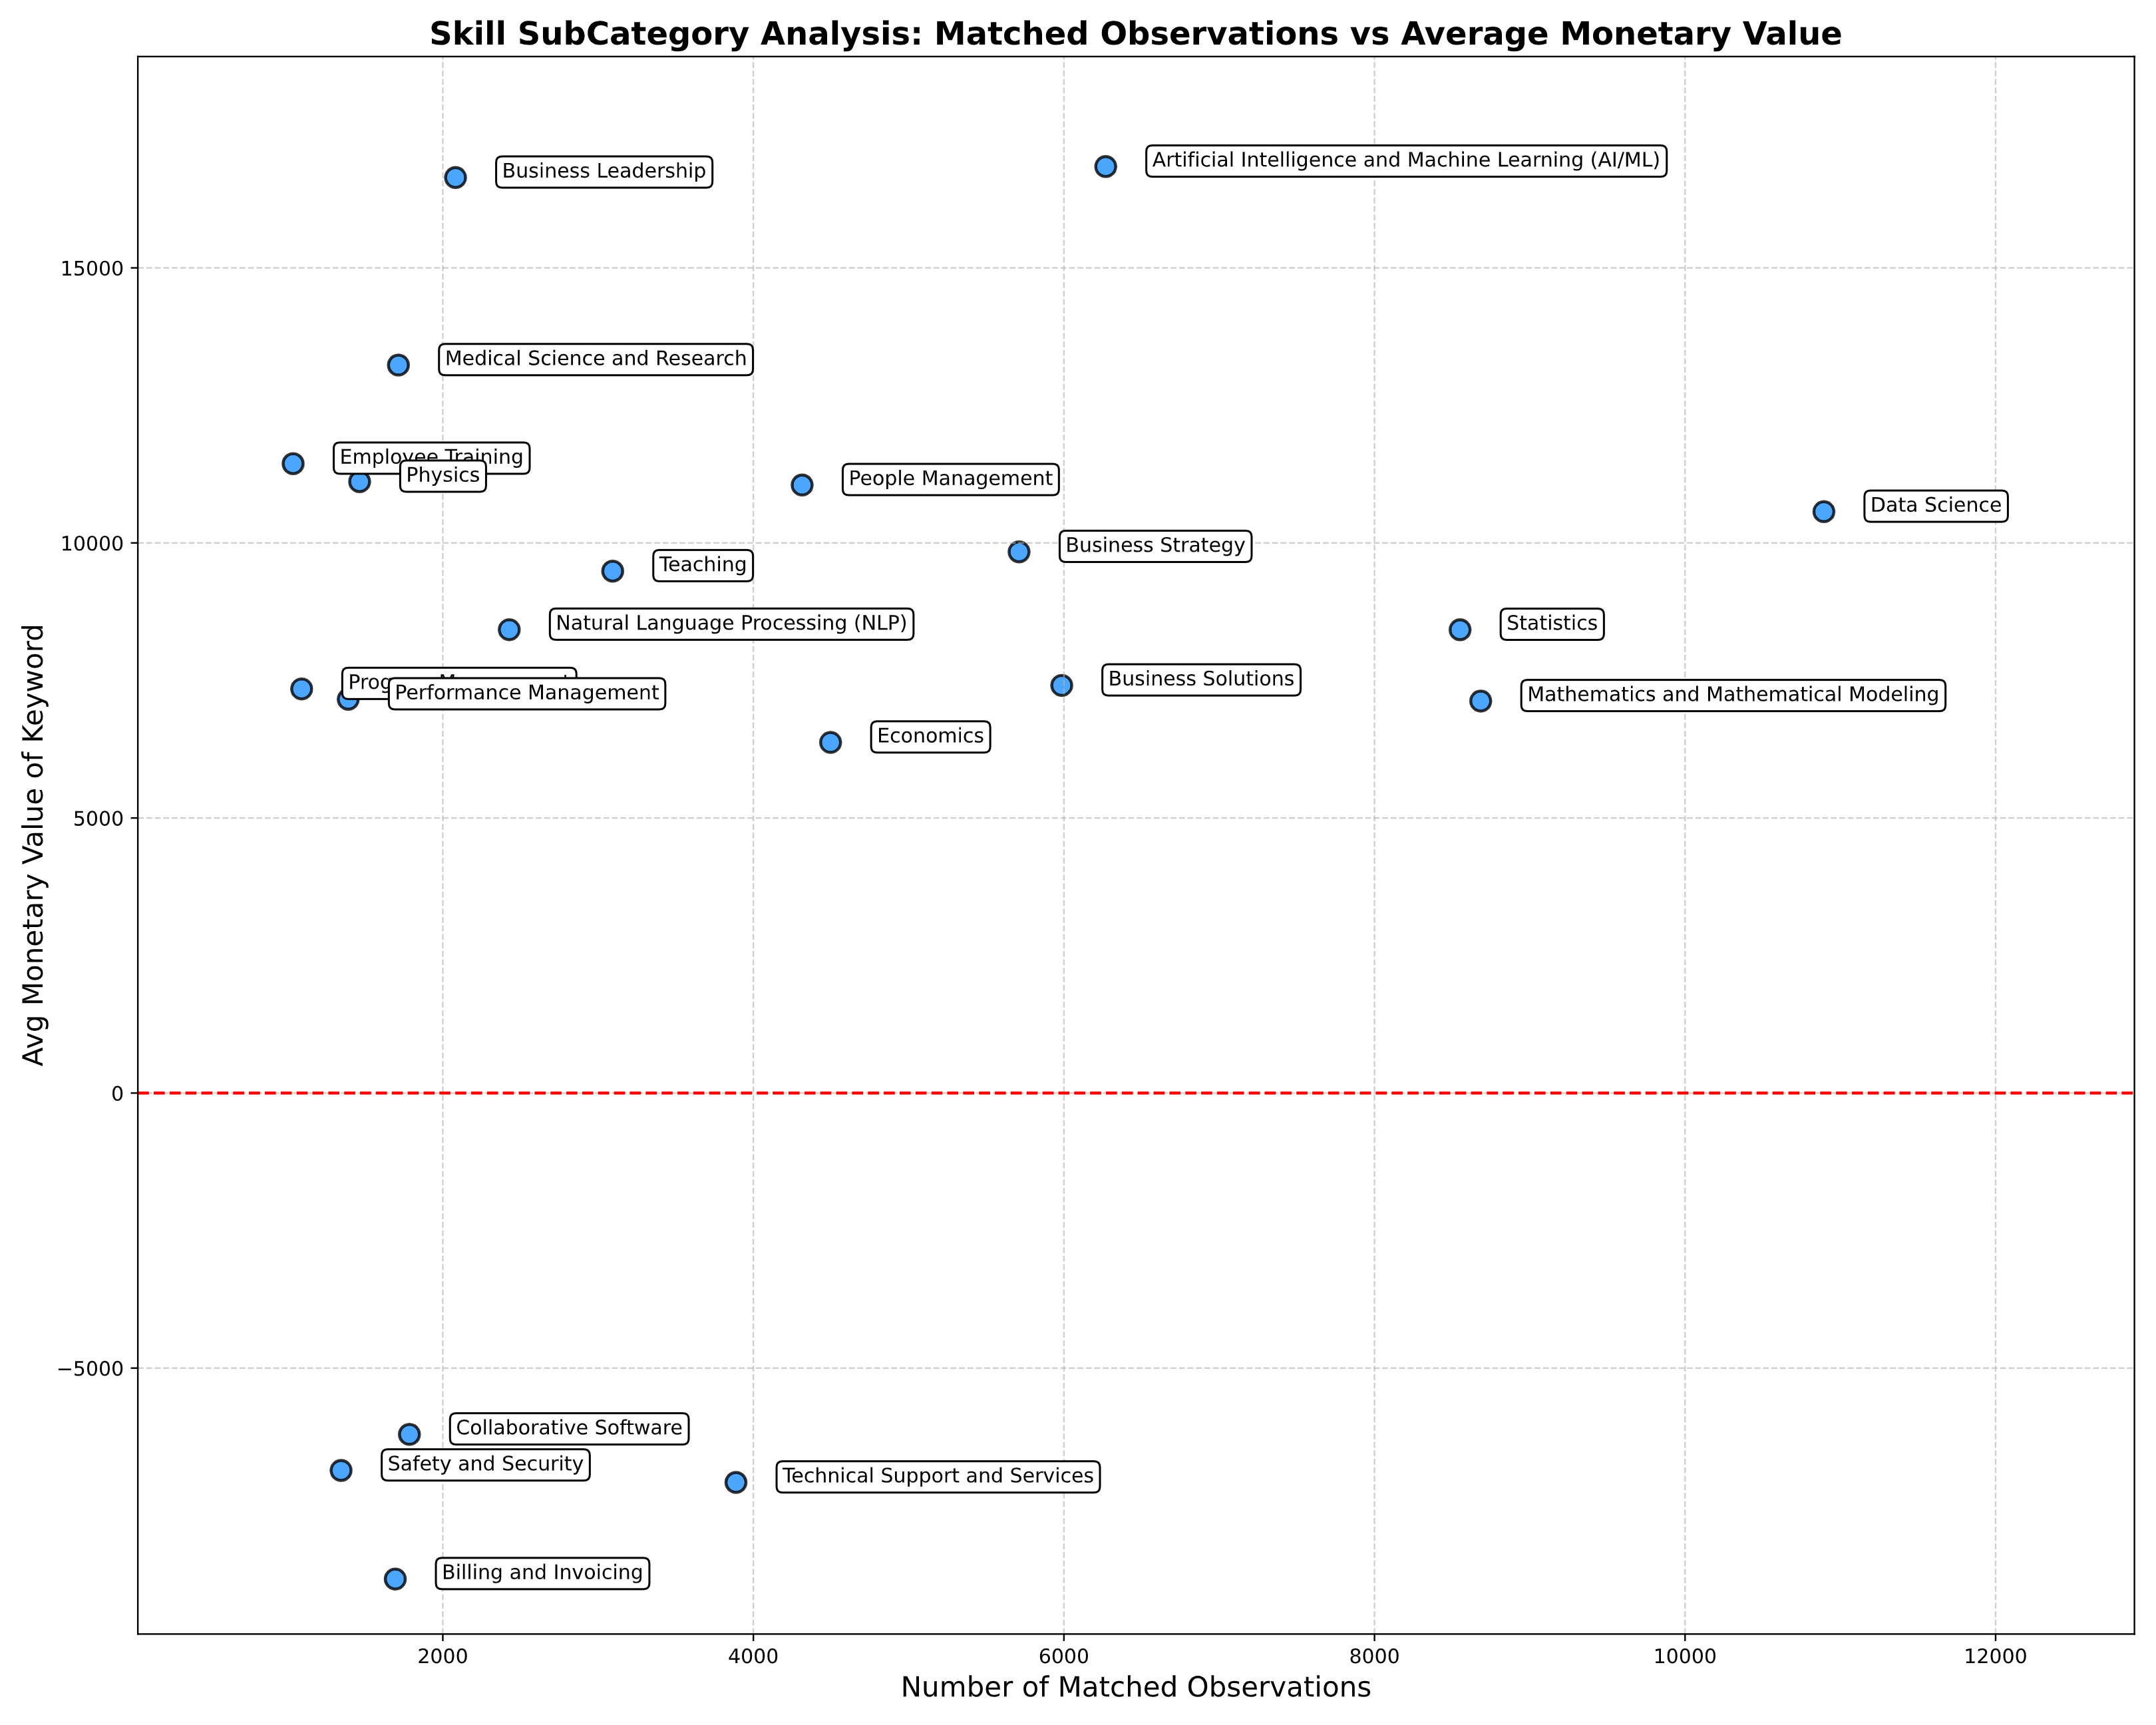
Findings from Skill Valuation
# of matched observations show skill demand
$ value show skill premium
Trade-Off Between Demand and Value:
High-value skills often have lower demand, indicating niche expertise.
High-demand skills tend to have moderate monetary value due to broader availability
One should balance the demand and the monetary value of the skill.
One should target the right quadrant of the plot where the skills have high demand and high value.
$ Value of Skill
Proxy for skill demand
Notes:
Understanding Skill Comolementarity is important because this information can be used by
Individual to identify the combination of skills to invest to produce higher salary jump
Employers use these skill combination to increase the output of their team
Again, Policy makers can use this
Use firm fixed effects using company

Slide 25
Contributions and Limitations
Contributions
Measures how skills impact salaries quantitatively
Provides a data-driven approach instead of relying on subjective skill rankings
Allows job seekers to make informed decisions about skill investments
Gives employers and policymakers clear salary benchmarks for various skills
Results validated using bootstrapping and counterfactual comparisons
Limitations
No existing benchmark to compare against
Findings limited to data scientist positions only.
Notes:
Understanding Skill Comolementarity is important because this information can be used by
Individual to identify the combination of skills to invest to produce higher salary jump
Employers use these skill combination to increase the output of their team
Again, Policy makers can use this

Slide 26
Certain Pertinent Questions
Skill valuation tells how much one skill adds to salary on average, but
Do Skills don’t exist in isolation?
People rarely use a single skill in a job.
Therefore, the next logical step is: Understanding Skill Complementarity i.e. which skills, when combined, drive the highest salary growth.
Notes:
Understanding Skill Comolementarity is important because this information can be used by
Individual to identify the combination of skills to invest to produce higher salary jump
Employers use these skill combination to increase the output of their team
Again, Policy makers can use this
Use firm fixed effects using company

Slide 27

Skill Complementarity
From Skill Valuation to Skill Synergy

Slide 28
Motivation for Skill Complementarity
Job Seekers
Employers
Invest in powerful skill combinations
Optimize hiring by identifying synergistic skill sets
Policymakers
Design training programs that teach valuable skill pairs
Reality of Skills
Success isn't built on single skills—it's driven by strategic skill combinations
Skills amplify each other: Together, they're worth more than their individual values suggest
Example
Python alone: +$5,000
Python + Machine Learning: +$20,000
Which skill combinations drive exceptional salary growth?
Notes:
Understanding Skill Comolementarity is important because this information can be used by
Individual to identify the combination of skills to invest to produce higher salary jump
Employers use these skill combination to increase the output of their team
Again, Policy makers can use this

Slide 29
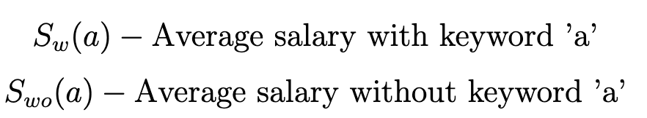
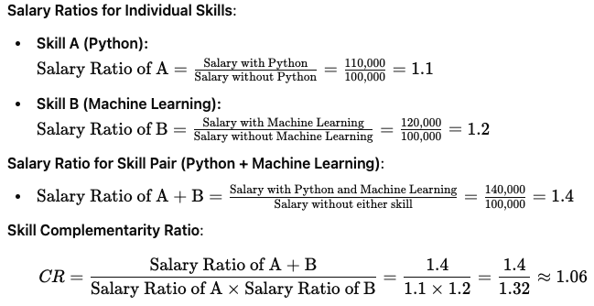
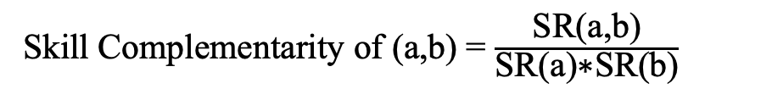
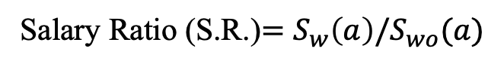
Calculating Skill Complementarity
We use the same algorithm that we used previously to calculate the monetary value of individual keyword as well as keyword pair
Salary Ratio (S.R.)$=S_{w}\left(a\right)/S_{wo}(a)$
Skill Complementarity of (a,b) = $\frac{\text{SR}\text{(}\text{a}\text{,}\text{b}\text{)}}{\text{SR}\text{(}\text{a}\text{)∗}\text{SR}\text{(}\text{b}\text{)}}$
Ex: A Skill Complementarity value of more than 1 would mean that the skills have synergistic effect and together produce high output than their individual contributions to salary.
Notes:
Understanding Skill Comolementarity is important because this information can be used by
Individual to identify the combination of skills to invest to produce higher salary jump
Employers use these skill combination to increase the output of their team
Again, Policy makers can use this
If the text use and or , it might. Be useful

Slide 30
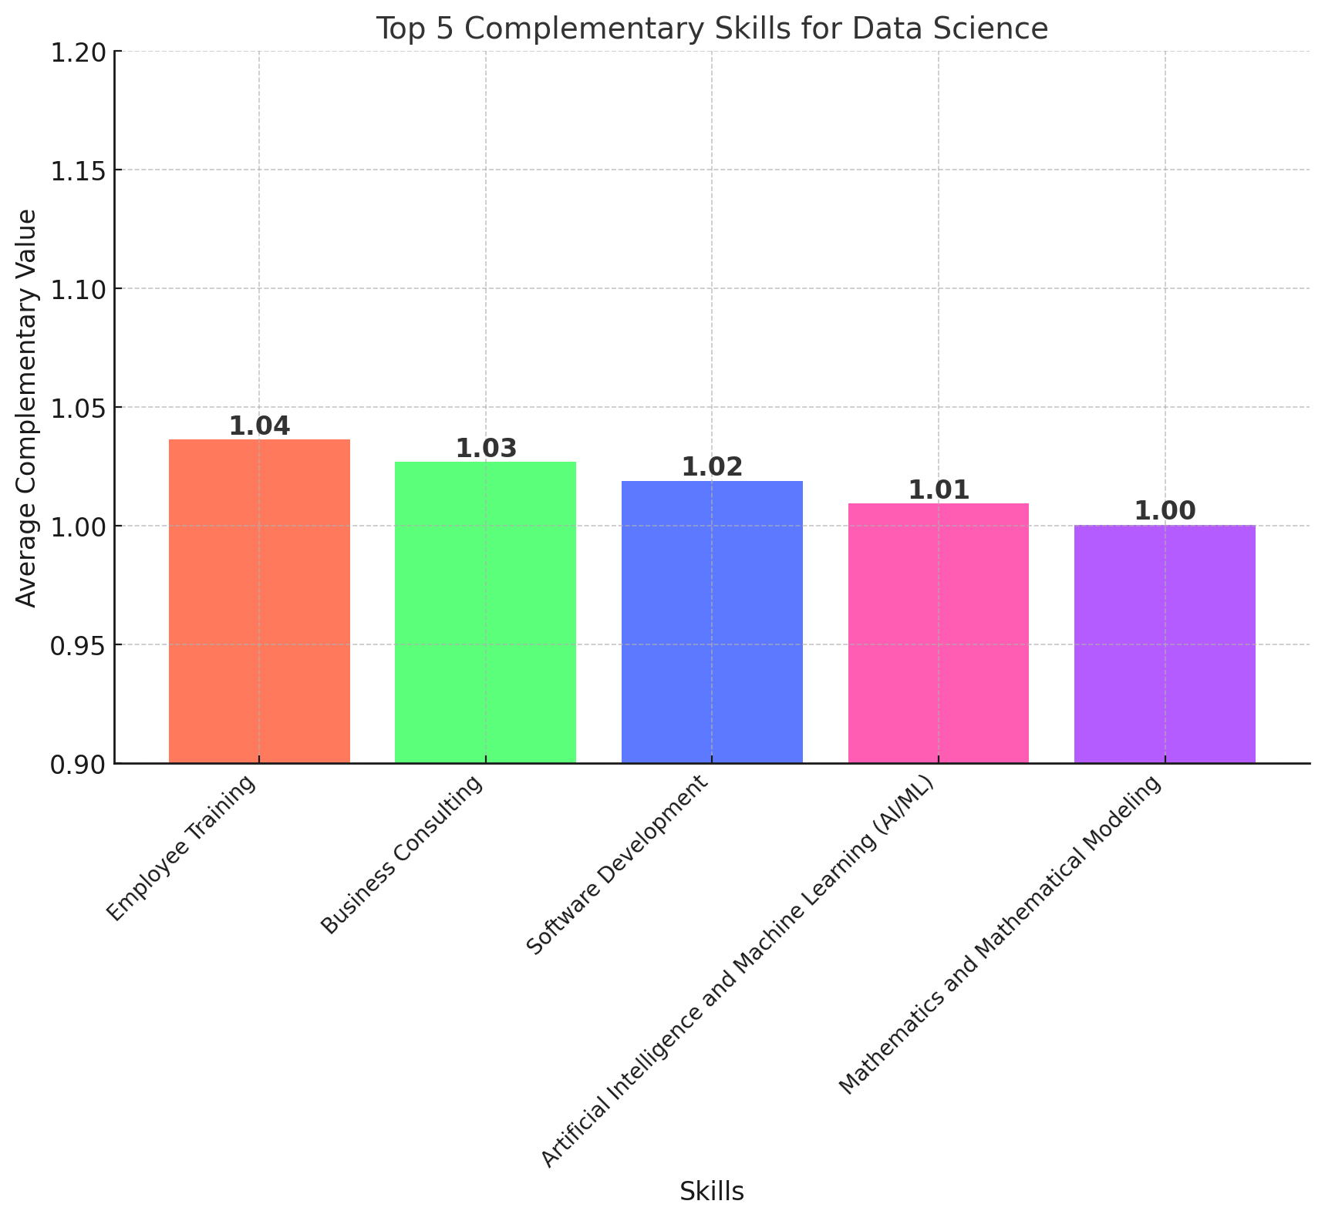
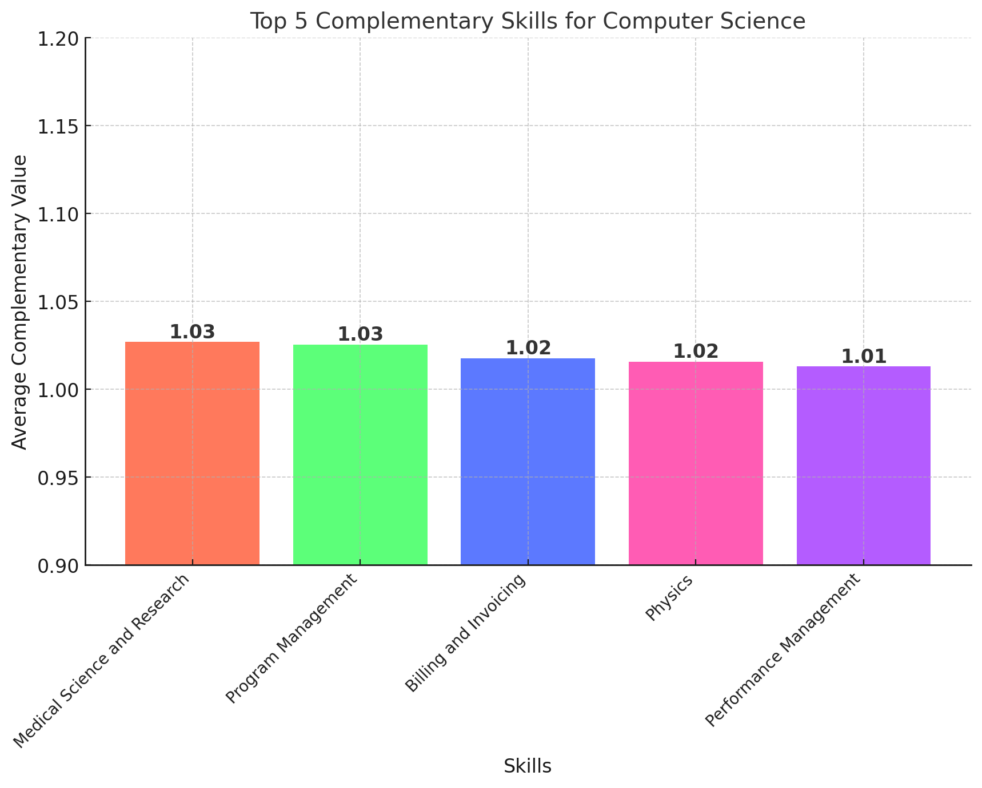
Findings of Skill Complementarity
The above diagram shows which skills are most complementary to a given skill:
For Data Science Skill, the top 3 most complementary skill are Employee Training, Business Consulting, Software Development
For Computer Science Skill, the top 3 complementary skill is Medical Science & Research, Program Management, Billing & Invoicing
Notes:
Understanding Skill Comolementarity is important because this information can be used by
Individual to identify the combination of skills to invest to produce higher salary jump
Employers use these skill combination to increase the output of their team
Again, Policy makers can use this

Slide 31
Key Takeaways and Contributions
Impact & Applications
Quantified interactions between complementary skills
Provided actionable insights for job seekers, employers, and educators
Created data-driven framework for measuring skill synergies
Key Contributions
Developed accurate salary prediction model
Measured monetary value of individual skills
Demonstrated how skill combinations increase market value
Notes:
Understanding Skill Comolementarity is important because this information can be used by
Individual to identify the combination of skills to invest to produce higher salary jump
Employers use these skill combination to increase the output of their team
Again, Policy makers can use this

Slide 32
Future Work
Share work on salary prediction, skill value and complementarity with wider public for zero cost
Expand analysis across diverse industries and track skill trends over time.
Apply findings to shape workforce policies and development initiatives.
Use sparse matrix filling techniques to find values of skill combinations that don’t appear in the training data.
Notes:
Understanding Skill Comolementarity is important because this information can be used by
Individual to identify the combination of skills to invest to produce higher salary jump
Employers use these skill combination to increase the output of their team
Again, Policy makers can use this

Slide 33

Thank you!
Questions?
Nikhil Narayane
nnaraya2@utk.edu

